Slide 1
JS Frameworks
Velkata

Slide 2
Disclaimer:
This presentation is a mix of internet sources and its purpose is to show how JavaScript can be used as Object Oriented Language.
None of the content is created by me ☺ , I have only combined the sources for the purpose of presentation.

Slide 3
MVC (Model View Controller)
is a software architecture pattern which separates the representation of information from the user's interaction with it.
Controller - can send commands to its associated view to change the view's presentation of the model
Model - notifies its associated views and controllers when there has been a change in its state.
View - requests from the model the information that it needs to generate an output representation to the user.

Slide 4
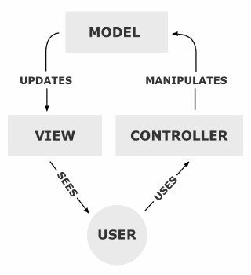
MVC (Model View Controller) Diagram

Slide 5
MVVM (Model View ViewModel)
is an architectural pattern based on MVC and MVP(Model–view–presenter) which attempts to more clearly separate the development of user-interfaces (UI) from that of the business logic and behaviour in an application.
MODEL – the model refers to either (a) a domain model which represents the real state content (an object-oriented approach), or (b) the data access layer that represents that content (a data-centric approach).
VIEW – Label, Button … stuff visible to the client, (developed by UI Designer)
VIEWMODEL - “model of the view” meaning it is an abstraction of the view that also serves in mediating between the view and the model which is the target of the view data bindings
KNOCKOUT Example: http://weblogs.asp.net/shijuvarghese/archive/2011/08/21/building-javascript-mvvm-apps-in-asp-net-mvc-using-knockoutjs.aspx
Related JS frameworks: Knockout.js
Notes:
Data binding - http://en.wikipedia.org/wiki/Data_binding (Data binding is general technique that binds two data/information sources together and maintains synchronization of data. This is usually done with two data/information sources with different languages as in XML data binding. In UI data binding data and information objects of the same language but different logic function are bound together (e.g. Java UIelements to Java objects).
Domain model (ex.AD)- http://en.wikipedia.org/wiki/Domain_model (A domain model in problem solving and software engineering is a conceptual model of all the topics related to a specific problem. It describes the various entities, their attributes, roles, and relationships, plus the constraints that govern the problem domain.)
Data access layer (ex. Relational DB)- http://en.wikipedia.org/wiki/Data_access_layer (A data access layer (DAL) in computer software, is a layer of a computer program which provides simplified access to data stored in persistent storage of some kind, such as anentity-relational database.)

Slide 6
MVVM/MVC JS frameworks
Why client side code based on the MVVM/MVP/MVC Patterns? –
Flexibility
Code Reuse
Extendibility
Order
UI Bindings
Composed Views
Following some standards etc.
Where to use this? – single page apps, consume api-s, windows 8 apps, …. any kind of apps ☺
Dependency - jQuery, CoffeScript, underscorejs, handlebarsjs

Slide 7
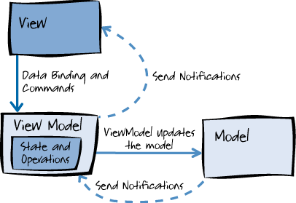
MVVM (Model View ViewModel) Diagram

Slide 8
MVVM/MVC JS frameworks
Most used JS frameworks:
Bakcbonejs
Angularjs
Knockoutjs
Meteorjs
Emberjs
Javascriptmvc
What a name: !!!! Batman.js
List of : http://js-toolbox.org/category/frameworks

Slide 9
MVVM/MVC like Sources
Articles:
http://addyosmani.com/blog/understanding-mvvm-a-guide-for-javascript-developers/
http://joel.inpointform.net/software-development/mvvm-vs-mvp-vs-mvc-the-differences-explained/
Pattern short explanation:
MVP - http://en.wikipedia.org/wiki/Model%E2%80%93view%E2%80%93presenter
MVC - http://en.wikipedia.org/wiki/Model%E2%80%93view%E2%80%93controller
MVVM - http://en.wikipedia.org/wiki/Model_View_ViewModel
JS Frameworks:
http://knockoutjs.com/
http://backbonejs.org/
http://angularjs.org/
http://emberjs.com/
http://todomvc.com/
http://js-toolbox.org/category/frameworks
http://www.faridesign.net/2012/04/20-javascript-frameworks-mvvm-templating-licenses-etc/
http://net.tutsplus.com/articles/web-roundups/20-javascript-frameworks-worth-checking-out/
http://en.wikipedia.org/wiki/Comparison_of_JavaScript_frameworks
http://www.quora.com/JavaScript/What-is-the-JavaScript-MVC-framework-with-the-most-momentum
Other but interesting:
http://lostechies.com/derickbailey/2011/12/23/backbone-js-is-not-an-mvc-framework/
http://weblogs.asp.net/shijuvarghese/archive/2011/08/21/building-javascript-mvvm-apps-in-asp-net-mvc-using-knockoutjs.aspx
http://codebrief.com/2012/01/the-top-10-javascript-mvc-frameworks-reviewed/

Slide 10
Additional JS libs for Microsoft guys
Linqjs - http://linqjs.codeplex.com/
JavaScript windows 8 apps

Slide 11
Q&A

